Slide 1
DSO 510 Project -
Cohort A
By: Dali Durazo, Mawada Felemban, Vivian Kong, Mei Lan Loh, and Scott Wais

Slide 2
What is the problem we are seeking to answer?
Is there a statistically significant relationship between the variability in average starting salary and the variability in acceptance rate for US undergraduate business schools?
Notes:
Question 1 Answer
More specific question:
Specifically, can the variability in the average salary be explained by the variability in acceptance rate for US undergraduate business schools, controlling for all our other variables.
Specifically can the variability in the average salary be explained by the variability in acceptance rate for US undergraduate business schools, controlling for all our other variables.
Specifically can the variability in the average salary be explained by the variability in acceptance rate for US undergraduate business schools, controlling for all our other variables.

Slide 3
The Importance of Using a Data-Driven Approach
Attending college requires a large financial and time investment, so in order to maximize return on investment, students should have concrete evidence before making college decisions.
We can use evidence gathered from our data-driven approach, rather than relying on preconceived beliefs as to the benefits of attending certain colleges
Notes:
Q2

Slide 4
Possible Outcomes
No relationship
Positive relationship
Negative relationship
Relationship caused by factors that we can’t conceptualize:
Funding
Cost of living
Average GPA
Companies that partner with certain universities
Classroom size
Enrollment
Notes:
Q2
Acceptance rate has no relationship with the average salary
When acceptance rate increases, the average salary increases
When acceptance rate decreases, the average salary increases

Slide 5
Ideal Experiment
The same person attending a random sample of universities
Controlling for all factors that could influence the relationship between acceptance rate and average salary
Notes:
Q2 - random, controlled

Slide 6
Data
Refer to references for data collection
Our data includes:
Multiple Datasets
Aggregated on the university level
Each row represents a U.S. undergraduate business school
Notes:
Q2 - To begin our data collection process, we found 1 table on acceptance rate and another table on average salary from Poets & Quants. Both tables were from 2018 and each contained data from 88 undergraduate business schools. We cleaned and merged these two tables to create our initial dataset. The data is aggregated at the university level.
Please also refer to our references at the end of the presentation for more detailed data collection and hyperlinks. We used multiple datasets, for example our universities_cleaned file.

Slide 7
Introducing the Data:
School | The university associated with the undergraduate business school
Acceptance Rate | The acceptance rate for each undergraduate business school in 2018
Average Salary | The average starting salary among recent 2018 graduates from each undergraduate business school
Public & Private | Whether the university is private or public Public takes on a value of 0 and Private takes on a value of 1
Reputation Score | The reputation score for each undergraduate business school
Alumni | The published alumni size for each undergraduate business school
Tuition and Fees | The tuition for each undergraduate business school
Distance to Nearest City | The distance from the university to the nearest major U.S. in miles We defined a major U.S. city as those: Being in the top 30 for population size in the U.S. Being in the top 15 U.S. cities for cumulative Fortune 500 revenue
Notes:
Q4
We enriched our data by manually collecting the remaining variables of interest.
Say what is on the slide for each variable but:
Public and Private - went to U.S. News to find out the designation of each university.
Reputation Score - we used the reputation scores that were gathered by Poets and Quants and filled them in according to the school
Alumni - went to each universities website and found their official alumni count
Tuition and Fees - went to college tuition compare.com and filled in the tuition for each school accordingly
Distance - went to Google Maps and found the coordinates of each undergraduate business school and nearest U.S. city

Slide 8
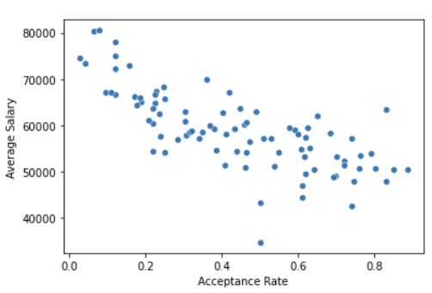
Descriptive Statistics: Acceptance Rate vs. Average Salary
Notes:
There is a negative relationship between acceptance rate and average salary. When the acceptance rate increases, the average salary decreases.
Highlight the fact that we wanted to review the relationship between these variables prior to going in depth

Slide 9
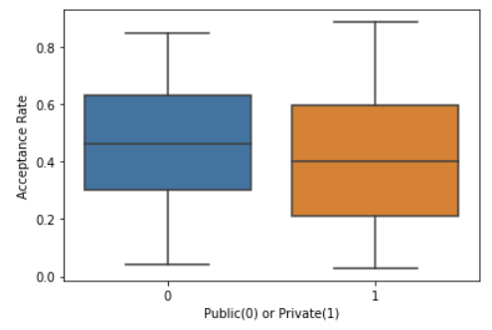
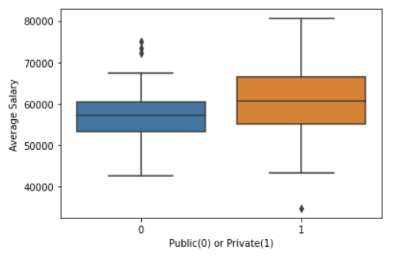
Descriptive Statistics: Public vs Private

Slide 10
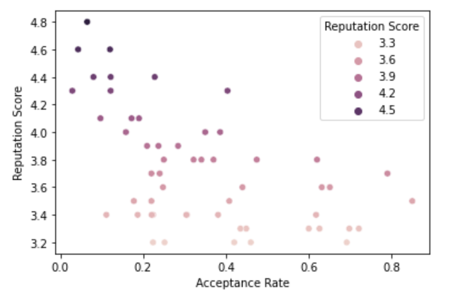
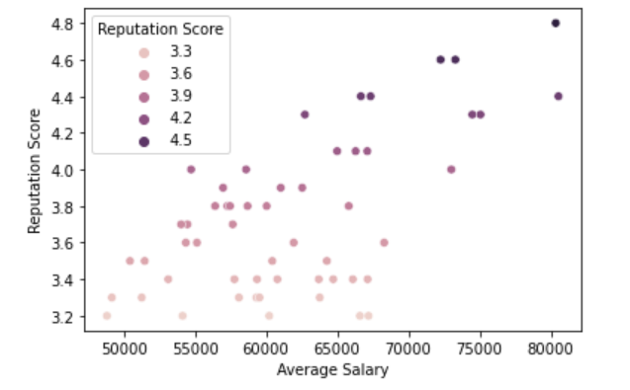
Descriptive statistics: Reputation Score
Relationship of Reputation Score and Acceptance Rate
Relationship of Reputation Score and Salary

Slide 11
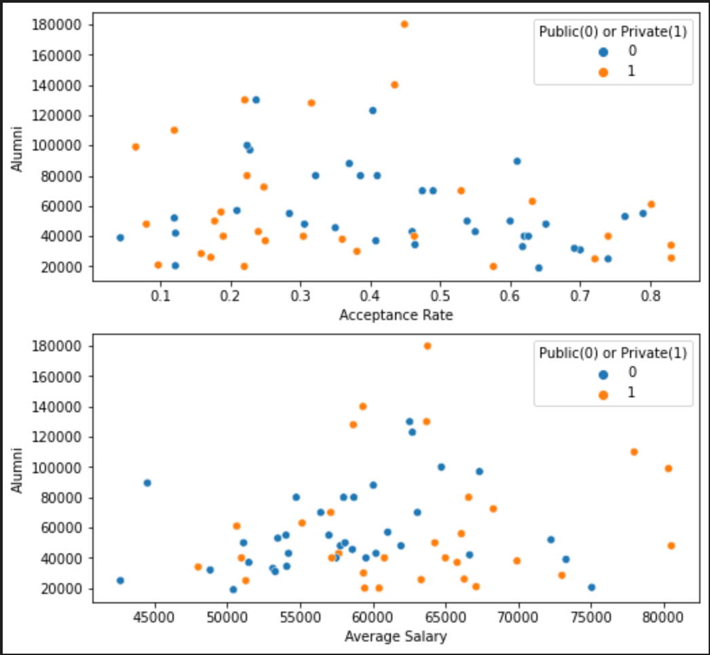
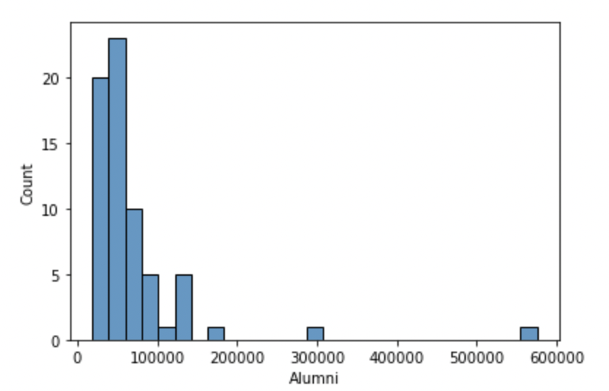
Descriptive statistics: Alumni Size
Notes:
Q5

Slide 12
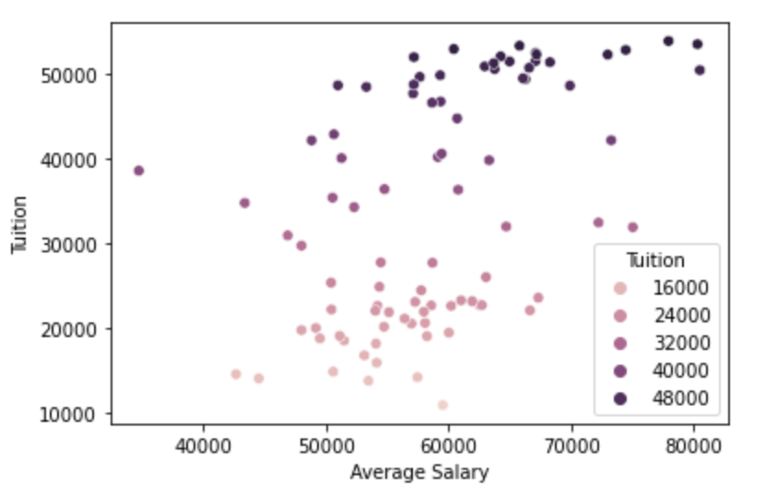
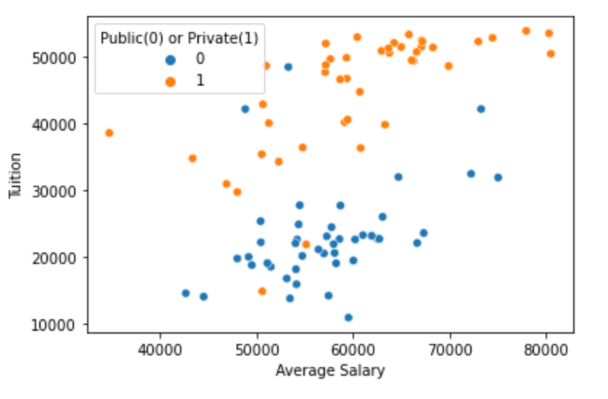
Descriptive statistics: Tuition
Relationship of Tuition to Salary Relationship of Tuition to Salary with type of school
Notes:
Q5

Slide 13
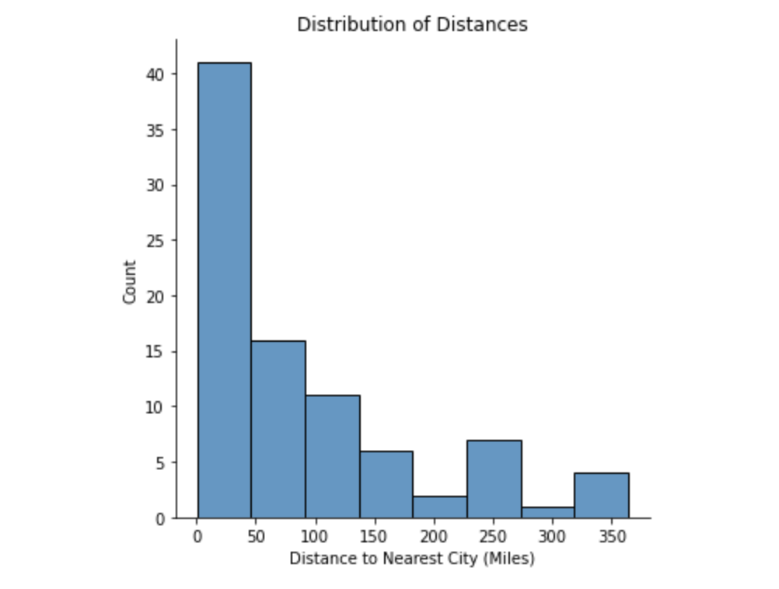
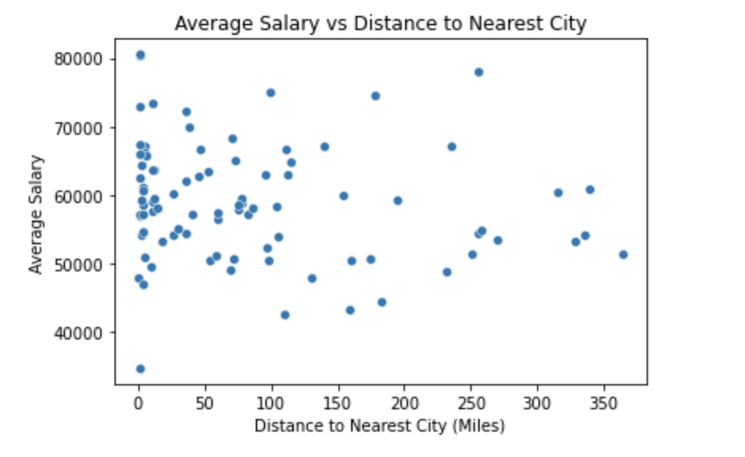
Descriptive statistics: Distances
Notes:
Q5

Slide 14
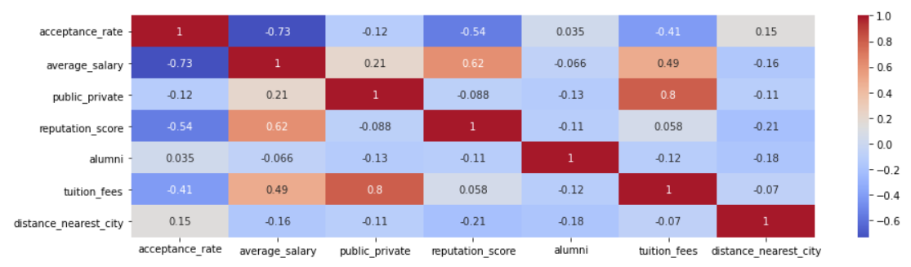
Descriptive statistics: Correlation

Slide 15
Limitations & Data Discrepancies
Outliers
Missing data on reputation score
Possible biases on reputation score collection
School Deans are filling out surveys
Missing data on alumni size + Calculation differences for alumni size
Human error
How did we handle this?
For missing alumni size data, we replaced it with the median alumni size
For high outliers in alumni size, we took the log of the sizes
For missing reputation score, we filled values based on average salary
Notes:
Q6

Slide 16
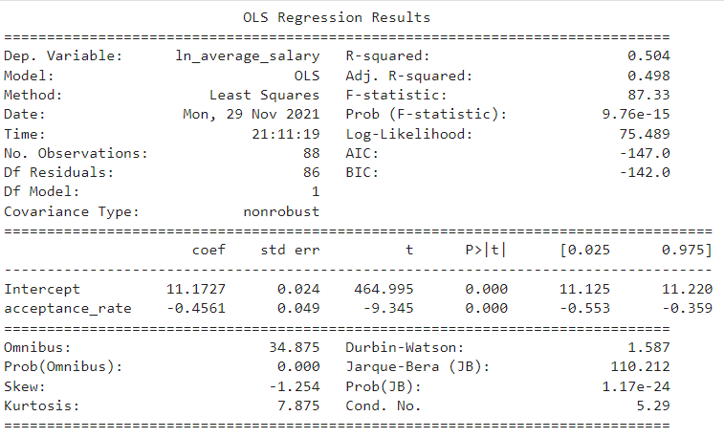
Univariate Output
Notes:
Before building a final model, we regressed ln_average salary on acceptance rate
The dependent variable is logged so that we can speak in terms of percentage change in average salary
The p-value for the estimated slope coefficient indicates that there is a significant relationship between acceptance rate and ln_average salary

Slide 17
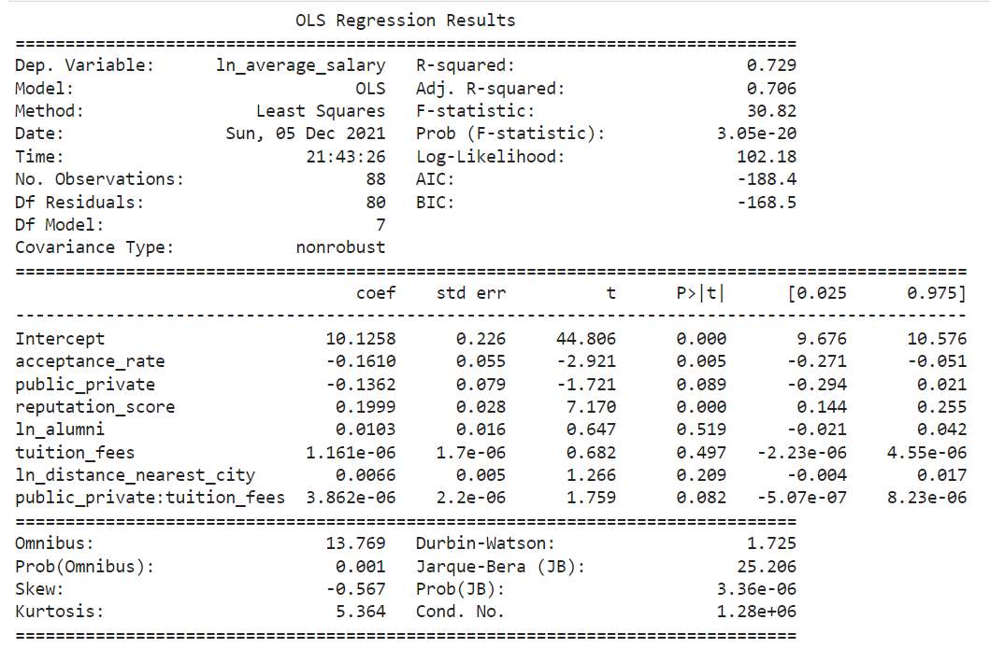
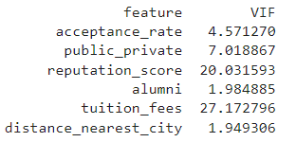
Multivariate Output
Notes:
After running the univariate regression and aggregating the findings from our exploratory analysis, we prepared the data for our multivariate regression model:
Logged alumni because the data were right-skewed
Logged distance_nearest_city because the data were right skewed
Added interaction term between public_private and tuition_fees because the relationship between tuition_fees and average_salary appears to differ between public and private schools
Interpretation of Coefficients:
b₀ = When the linear inputs are equal to zero and the logged inputs are equal to 1, the estimated average starting salary is $23,979
b₁ = Controlling for the other regressors, a 1 unit increase in acceptance rate corresponds to a 14.9 % decrease in estimated average_salary. 𝛽₁ differs significantly from zero.
b₂ = Controlling for the other regressors and setting tuition_fees equal to zero, the estimated average_salary is 12.8% lower for private schools than for public schools. 𝛽₂ does not differ significantly from zero.
b₃ = Controlling for the other regressors, a 1 unit increase in reputation score corresponds to a 22.1% increase in estimated average_salary. 𝛽₃ differs significantly from zero.
b₄ = Controlling for the other regressors, a 1% increase in alumni corresponds to a 0.01% increase in estimated average_salary. 𝛽₄ does not differ significantly from zero.
b₅ = Controlling for the other regressors and setting public_private to zero, a 1000 unit increase in a tuition_fees corresponds to a 0.1% increase in estimated average_salary. 𝛽₅ does not differ significantly from zero.
b₆= Controlling for the other regressors, a 1% increase in distance_nearest_city corresponds to a 0.0066% increase in estimated average_salary. 𝛽₆ does not differ significantly from zero.
b₇=Controlling for the other regressors and setting public_private equal to 1, a 1000 unit increase in tuition_fees corresponds to a 0.5% increase in estimated average_salary. 𝛽₇ does not differ significantly from zero.
The r-square value indicates that 73% of the variation in ln_average_salary is explained by the variation in the regressors.
VIF calculations show that reputation_score and tuition_fees are highly correlated with one or more of the other independent variables
Although there are significant issues with the model overall, such as high p-values for our coefficients and severe multicollinearity, we can now provide a more robust answer to our original question than we could after running the univariate regression.
Controlling for the five variables we collected, we can reject the null hypothesis that there is no relationship between the variability in acceptance rate the variability in average salary for US undergraduate business schools.
Still, because this model does not approach the requirements of the ideal experiment, we should not assume that a causal relationship is present.

Slide 18
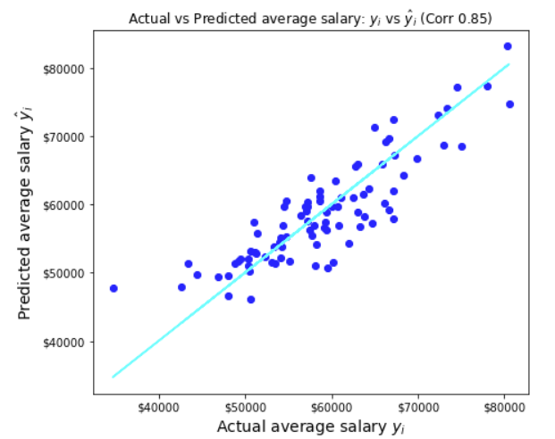
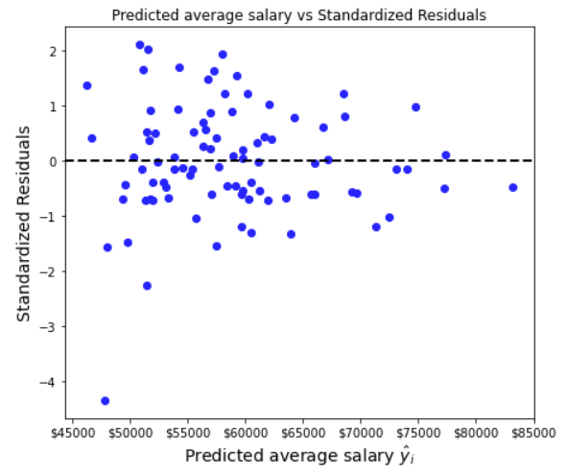
Residual Analysis
Notes:
As an intro to an expanded analysis, we have included plots for actual average salary vs predicted average salary, and predicted average salary vs the standardized residuals. We see that there is one significant outlier, that has an observed average salary more than 4 standard deviations below its expected value. This observation corresponds to the Hult International Business School.

Slide 19
References
Poets and Quants. “Wharton Again Tops US News Ranking of Best Undergrad Business Programs.” (2020, September 14). Poets and Quants.
Carnegie Mellon University. “US News & World Report Ranks Tepper Undergrad Business Program #7.” (2020, September 15). Carnegie Mellon University.
College Tuitions
Alumni Size Data
Distance to the nearest city for schools in the data
Google maps for distance
Public vs. Private school data
Notes:
Question 5 Answer

Slide 20
THANK YOU

